Slide 1
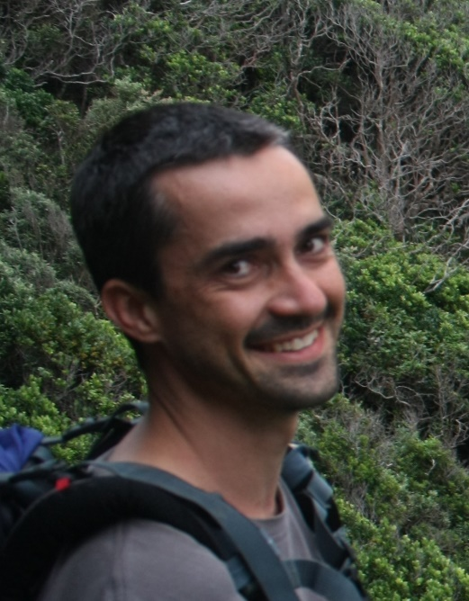
Dugal Harris
LEVEL: PhD
TOPIC: Very High Resolution Remote Sensing of Carbon Stocks in
Subtropical Thicket
PROJECT: GEF5
STUDY AREA: Baviaanskloof and Little Karoo
KEY QUESTIONS:
Can satellite and or aerial imagery be used to map above ground carbon stocks in Subtropical Thicket?
How might phenological, degradation and habitat variations affect the application of the mapping technique?
Can supplemental data from drone imagery be used to improve mapping accuracy?
KEY FINDINGS:
Aerial imagery can be calibrated to achieve radiometric consistency
Spekboom canopy cover can be successfully mapped using aerial imagery (in the Little Karoo)
KEY RECOMMENDATION:
- Remote sensing requirements should be considered when planning and executing carbon stock baseline monitoring

